Slide 1
How to Start/Create Application
A Django project contains one or more applications which means we create application inside Project Folder.
Syntax:- python manage.py startapp appname
Creating One Application inside Project:-
Go to Project Folder
Run Command python manage.py startapp course
Creating Multiple Applications inside Project:-
Go to Project Folder
python manage.py startapp course
python manage.py startapp fees
python manage.py startapp result

Slide 2
How to Install Application in Our Project
As we know a Django project can contain multiple application so just creating application inside a project is not enough we also have to install application in our project.
We install application in our project using settings.py file.
settings.py file is available at Project Level which means we can install all the application of project.
This is compulsory otherwise Application won’t be recognized by Django.
Open settings.py file
INSTALLED_APPS = [
‘django.contrib.admin’,
‘application_name1’,
‘application_name2’,
]
Save settings.py File
INSTALLED_APPS = [
‘django.contrib.admin’,
‘course’,
]
INSTALLED_APPS = [
‘django.contrib.admin’,
‘course’,
‘fees’,
‘result’,
]

Slide 3
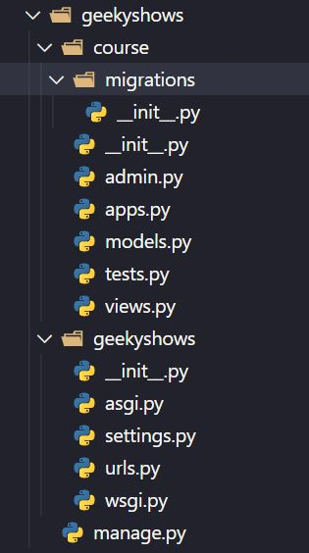
Geeky Steps
Create Django Project: django-admin startproject geekyshows
Change Directory to Django Project: cd geekyshows
Create Django Application: python manage.py startapp course
Add/Install Application to Django Project (course to geekyshows)
Open settings.py
Add course
INSTALLED_APPS = [‘django.contrib.admin’,‘course’, ]
Save settings.py

Slide 4
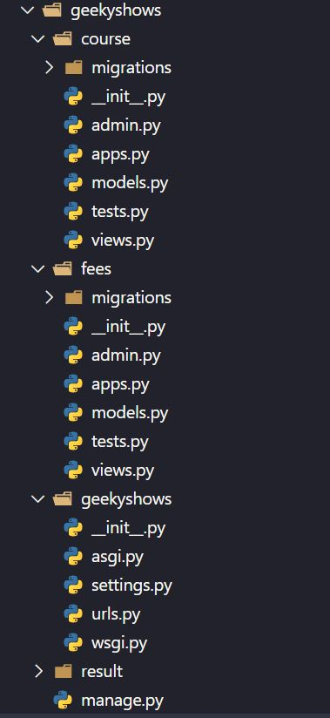
Geeky Steps
Create Django Project: django-admin startproject geekyshows
Change Directory to Django Project: cd geekyshows
Create Django Application1: python manage.py startapp course
Create Django Application2: python manage.py startapp fees
Create Django Application3: python manage.py startapp result
Add/Install Applications to Django Project
Open settings.py
Add course, fees, result
INSTALLED_APPS = [‘django.contrib.admin’,‘course’, ‘fees’ , ‘result’ ,]
Save settings.py

